Slide 1
Student Management
System
Our OOP Project Presentation Begins Here…

Slide 2
Basic Concepts Of OOP
Let’s have an idea about fundamental principles of OOP before we start
Classes | Class is a blueprint of encapsulated attributes & methods relevant to its entity
Inheritance | Used to establish relationships between classes.It inherits common attributes & methods
Polymorphism | It allows functions to behave differently based on the object which it calls
Encapsulation | Restricting direct access to attributes & methods promotes data security and intergrity
Abstraction | It involves simplifying complex systems.Allows to define common methods
Association and Aggregation | Describes relationship between two or more classes.Allows objects to assiociate with others
Module:
Object Oriented Programming - Java
Team Members:
NiKi | Navod | Dilshan | Sasinda

Slide 3
Introduction
The student management system designed to automate the administrative tasks associated with students in an educational institute.The system implemented with Object Oriented Programming concepts to create structured blueprint of real world entities
This java project aims to provide an efficient platform to manage student related data such as courses,lectures,reports etc…
Those are represented as objects with their own properties and behaviors.
The system allows to create,update,remove & analyze these objects.

Slide 4
Table of contents
01
02
03
04
Project Objectives
Applying OOP Concepts
Describe the target area & the purposes of the program
Implementing various concepts into classes
Objects & Methods
Advantages
Creating objects for function calling
Briefly describing summary & the benifits

Slide 5
01
Project Objectives
Let’s talk about the project goals

Slide 6
Objectives
This system based on the students and their connections.So the system should have features to manage their activities & associations.Basically we’ve implemented some key aspects into this system:
Student Information Management – To store and manipulate data relevant to students including personal details, personal records, project involvement & parent information.
Courses & Enrollment Management – Facilities to registration,Course enrollment,Ability to select upto 2 courses at the same time,Update or remove selected courses.
Grades and Performance Management – System can provide reports to take feedback & can generate GPA score to maintain student’s performance.
These are the main features of the system & there are some additional features as well. (Lecturer management)

Slide 7
Object & Relationship Diagram
Student
Lecturer
Projects
Junior
Senior
Student 1
Dean
Student 2
Parent 1
Batch Refree
Student 3
Parent 2
Student 4
Basic Entities
Student Registration
Reports
Courses
Derived Entities
(Inheritance)
Student
Student
Association
This diagram shows the levels of relationships & how the entities are connected each other

Slide 8
—Albert Schweitzer
“Success is not the key to happiness.Happiness is the key to success.If you love what you are doing,you will be successful.”

Slide 9
02
Applying OOP Concepts
Dispersing concepts through the relationships

Slide 10
Applied Concepts
Abstraction
Encapsulation
Inheritance
Everything inside the classes.System compressed
Internal implementations are collapsed
Deriving sub classes from super classes.Attributes inherits
Aggregation
Composition
Polymorphism
One class can have another class as attribute
One class can implement another class object
Variant use in functions.Behave by following object

Slide 11
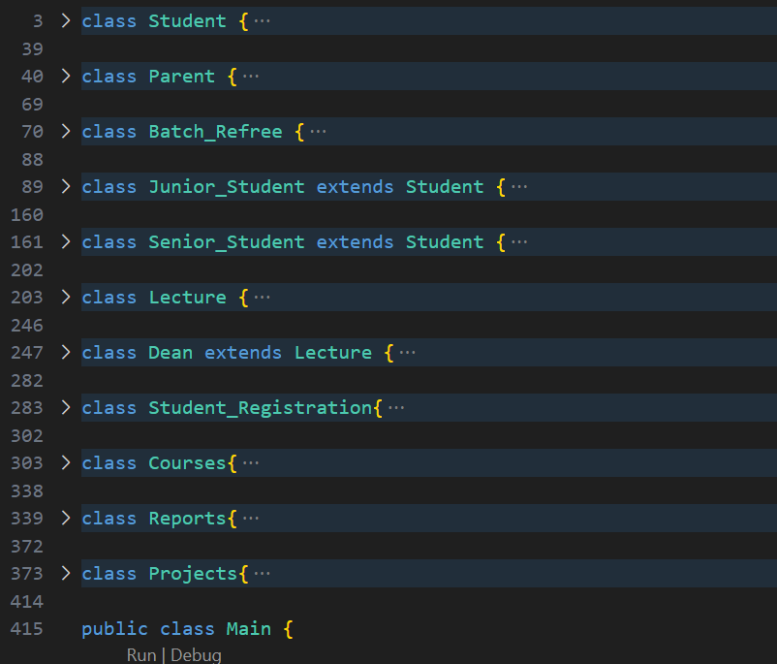
Abstraction
The Abstraction concept allows you to model real-world entities & their characteristics in a simplified way. User can create classes to represent objects where everything is written. Its easy to find errors & make changes in a particular part or object. So the abstraction hide the complexity of attributes and properties that are relevant to an object. Creating a blueprint for objects plays a part of code reusability.
Each class has specified variables & methods. Nothing outside the classes. This helps in designing the system more manageable, maintainable and extensible.
Hiding the complex internal implementation about how an object works is the major task of abstraction.

Slide 12
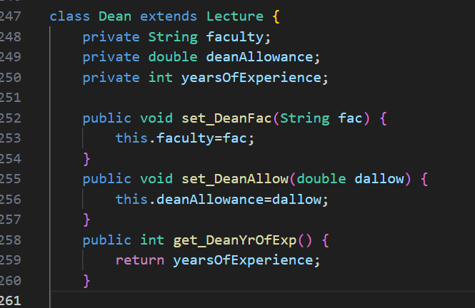
Encapsulation
The encapsulation refers to the concept of building data and the methods into a single unit. The key aspect of encapsulation is to hide the internal implementation of an object from outside. It expose only necessary interfaces what interacting with it. Encapsulation provides controlled access to the internal state of an object.
It can restrict the direct access by defining the attributes of a class as private or protected.
Instead of allowing direct access into the data, User can define public getter & setter methods to allow safe access to an object’s attributes. It prevents unauthorized modification & use.

Slide 13
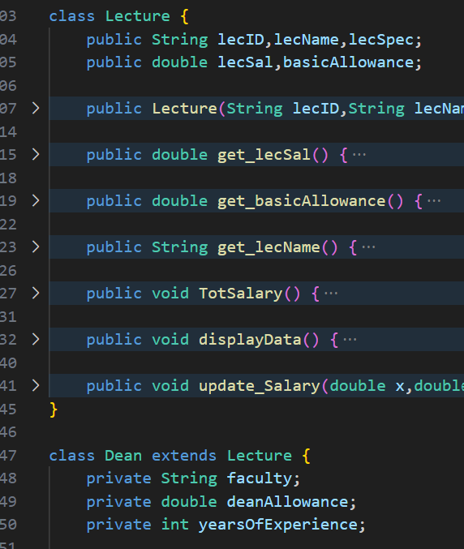
Inheritance
Inheritance allows you to create new classes based on existing classes. Base class define as parent class & Derived class define as child class. Inheritance allows to build a “IS-A” relationship. Derived class shares the attributes and behaviors of base class then it also can expand & specialize.
By the following example Lecture class acts as parent class.
It provides the common attributes and methods that are shared by one or more derived classes. It serves as template for another class.
Dean class is the derived class in this scenario, but it can be more sub classes there. Dean class owns the attributes of the Lecture class & can use every function as well. In the dean class can define more attributes & methods which is specialized only to dean class.

Slide 14
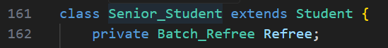
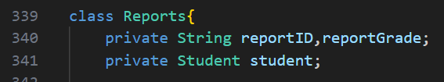
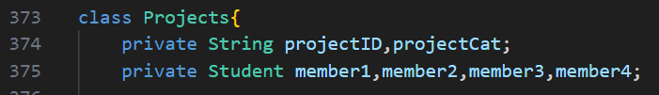
Aggregation
Aggregation represents a “HAS-A” relationship between the objects. It allows one class to contain or manage another class. It is loosely coupled relationship which means the objects can exist independently.
Aggregation can involve one to one or one to many relationships.
Look at these red lines in the examples. There is a class as an attribute in Senior_Student & Reports classes. It references as “Senior Student has Batch Referee” and “Reports has Student”. These classes can manage only existing objects in attributed classes. (Line 162,341)
There are 4 members as students in projects. In differ way we can say “Project can have ID, Category and 4 Students.
(Line 375)

Slide 15
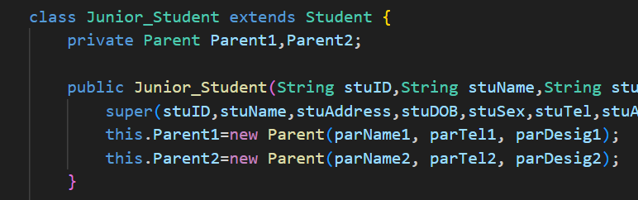
Composition
Composition is a “HAS-A” relationship which represents a stronger ownership where the parts are tightly bound together. In the composition, the whole object is responsible for the existence of its parts. When the whole object is destroyed, it’s parts are also typically destroyed. They don’t have a meaningful existence outside of it.
“A Junior Student has two Parents”
Yeah, you got that right way. When user creating a Junior Student object, two Parent objects must be created & assigned.
Those two parents can’t exist without that Junior Student object. If any Junior Object is deleted, the objects that relevant to its parents must be deleted.

Slide 16
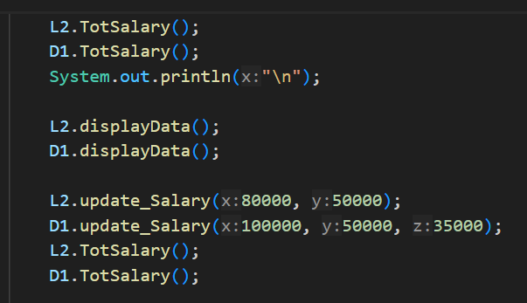
Polymorphism
This concept calls “one-size-fits-many”, because it allows different objects to respond to same function in a specific way. Polymorphism relies on method overriding, where a method has the same name, return type and parameters in both base class & derived class. The actual implementation may differ when the object is called by the derived class object.
This is a perfect example for to explain this concept.
As you can see, there is a same method which is called by the different objects, but the way it responds is not the same.
Method overloading is also there. In that case the formal parameters should be different.

Slide 17
More About Polymorphism
What is Method Overloading?
Ability to implement multiple methods with the same name in the same class but have different parameters.
The compiler detemines the correct method based on the arguments passed during a method call.
What is Method Overriding?
It occurs when a subclass provides a special implementation for a method that is already defined in its superclass.
Subclass method must have the same name, return type & parameters as the method in the superclass.

Slide 18
Access modifiers
Private
Protected
Public
Restrict the visibility of a class member from outside the class. It enforces strong encapsulation.
Allows access within the same package and subclass.
Used to provide controlled access to subclass members.
Allows access from anywhere.
Provides broadcast level of visibility.

Slide 19
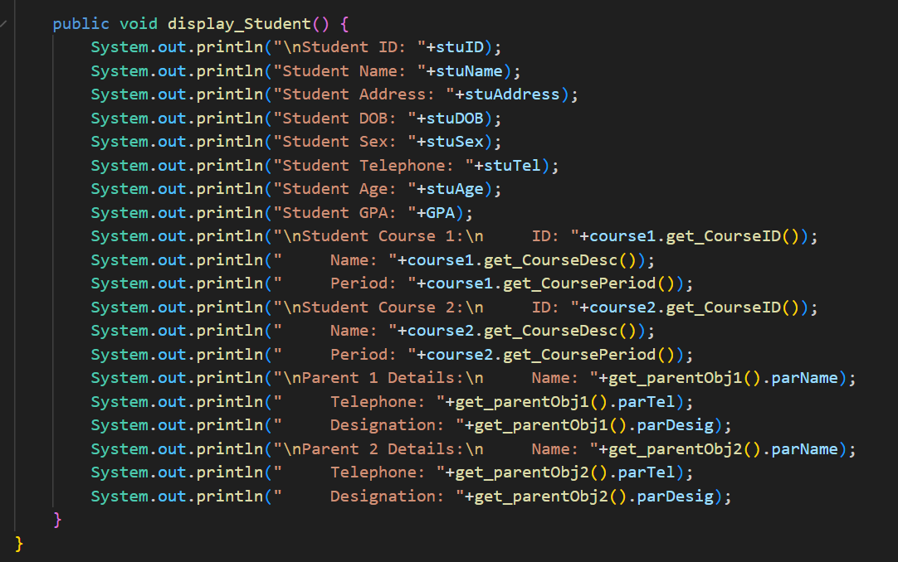
A perfect example for association
There are 3 different methods to output Junior Student information.
It has attributes from its superclass, attributes from its aggregated courses class & attributes from its composed parent class.
Superclass Attributes
Junior Student objects can directly access into its superclass attributes.
Getter function needs to access its aggregated attributes.
Required object getter to access its composed attributes.
Aggregated Attributes
Composed Attributes

Slide 20
—Gautama Buddha
“It is better to conquer yourself than to win a thousand battles. Then the victory is yours. It cannot be taken from you.”

Slide 21
03
Objects & Methods
Creating objects that can be used in method calls

Slide 22
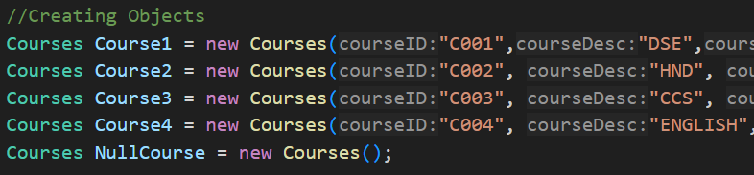
Objects are created using different constructors based on method calling purposes.
Object Creation
As the above example, We’ve allowed student to select maximum upto two courses but it’s not essential. Due to this particular reason, we’ve created “NullCourse” object for the students who wish to pursue only a single course.

Slide 23
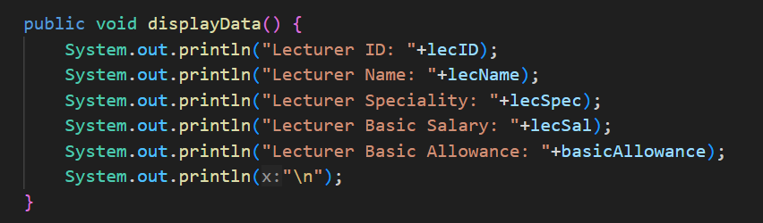
Display Functions
Each & every function has display method. It can output every details that are related to its object. Some functions are designed to access public variables, some of them are to access private data.

Slide 24
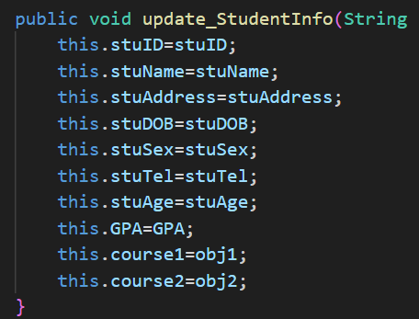
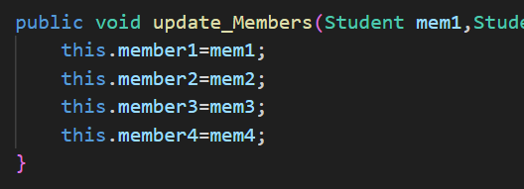
Update Functions
There are update functions on some classes for special purpose. If some data needs to change later, User can call these methods by its object.
One class may have different update methods based on its requirement.

Slide 25
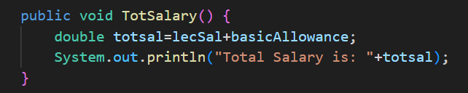
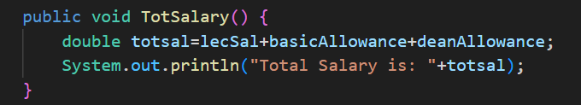
Overriding Functions
These two functions are placed on two inherited classes.
If superclass object calls the function, compiler will execute the first one.
Subclass object owns the second method.

Slide 26
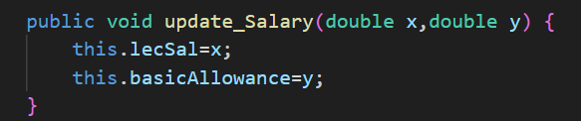
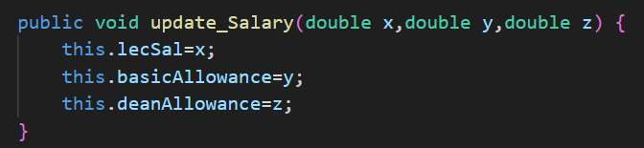
Overloading Functions
More likely the previous one but function execution is not based on the object, compiler will execute the right method by its passing arguments.
Can work within a same class. Inheritance isn’t must.

Slide 27
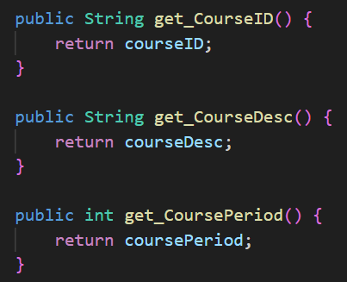
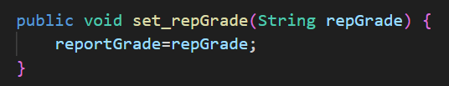
Getters & Setters
Getter & Setter methods are implemented because of restricted data access.
Get functions are used to return a value of a variable but it can be used to get an object as well.
Setters are used to set a value into a variable that can’t be access from outside.

Slide 28
Simple data types
Type | Size/Format | Description
Byte | 8-bit, 2's complement | 1-byte integer
Short | 16-bit, 2's complement | Short integer
Int | 32-bit, 2's complement | Whole
Long | 64-bit, 2's complement | Longint
Float | 32-bit, IEEE 754 | Real simple precision
Double | 64-bit, IEEE 754 | True double precision
Char | 16 bit character | Simple character

Slide 29
04
Advantages
Usage of the project and the benefits to user

Slide 30
Let’s categorize the advantages into two categories
Benefits & facts about the used code structure, applied concepts, implementations…
Code advantages
Advantages
If we consider this project as a foundation for a system or application
As a system advantages
*No complete system or application is included in this project

Slide 31



What can be done with Java examples?
Big data
AI
Video game
Mercury is the closest planet to the Sun and the smallest one of them all
Venus has a beautiful name and is the second planet from the Sun
Despite being red, Mars is actually a cold place. It’s full of iron oxide dust

Slide 32
4,498,300,000
Big numbers catch your audience’s attention

Slide 33
9h 55m 23s
333,000
386,000 km
Jupiter’s rotation period
The Sun’s mass compared to Earth’s
Distance between Earth and the Moon

Slide 34
Awesome words

Slide 35

A picture is worth a thousand words

Slide 36
Class operations
Static void main(String[] args) {
int a=10;
int b=5;
int sum=a+b;
int subtract=a-b;
int multiplication=a*b;
int division =a/b;
System.out.println("The sum of " + a + " plus " + b + " equals " + sum);
System.out.println("Subtraction of " + a + " minus " + b + " equals " + subtraction);
System.out.println("The multiplication of " + a + " by " + b + " is equal to " + multiplication);
System.out.println("The division of " + a + " by " + b + " is equal to " + division);

Slide 37
Brainstorming and idea generation
A | Abstract
B | Block
C | Class
D | Default
E | Enum
F | Field
G | Generic
H | Hexadecimal
I | Identifier
J | Java
K | Keyword
L | Lexical
M | Method
N | Native
O | Object
P | Package
Q | -
R | Reference
S | Sandbox
T | Thread
U | Unicode
V/W | Variable
X/Y | XML
Z | -

Slide 38
Thanks!
Do you have any questions?
youremail@freepik.com
+34 654 321 432
yourwebsite.com
Please keep this slide for attribution

Slide 39
Fonts & colors used
This presentation has been made using the following fonts:
Anton
(https://fonts.google.com/specimen/Anton)
Catamaran
(https://fonts.google.com/specimen/Catamaran)
#fafafa
#0e0e0e
#2e2e2e
#0f0f0f
#00c3da
#0b8eda
#7800da
#da0078

Slide 40


